Slide 1

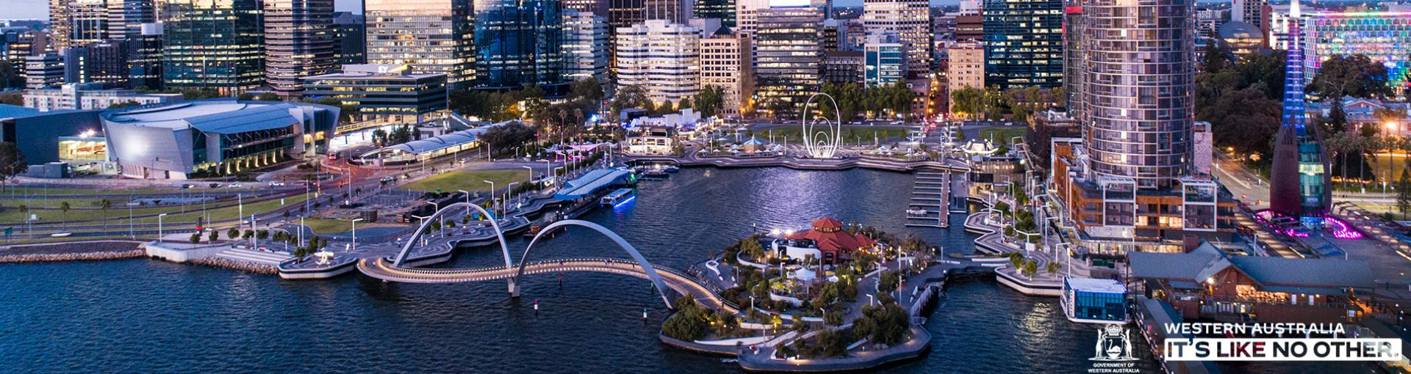
Introduction to geography

Slide 2
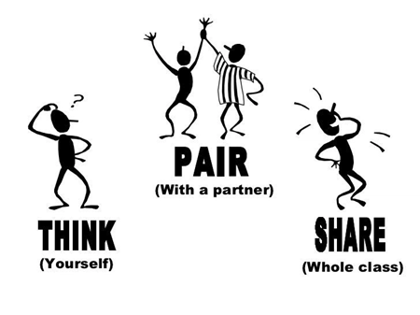
What is Geography?
Think, Pair, Share

Slide 3


What is geography?
Geography is
The study of EVERYTHING on Earth
Landforms, people, climates, cultures, etc.
Goal is to better understand:
How the Earth is changing
How humans influence the environment and vice versa

Slide 4
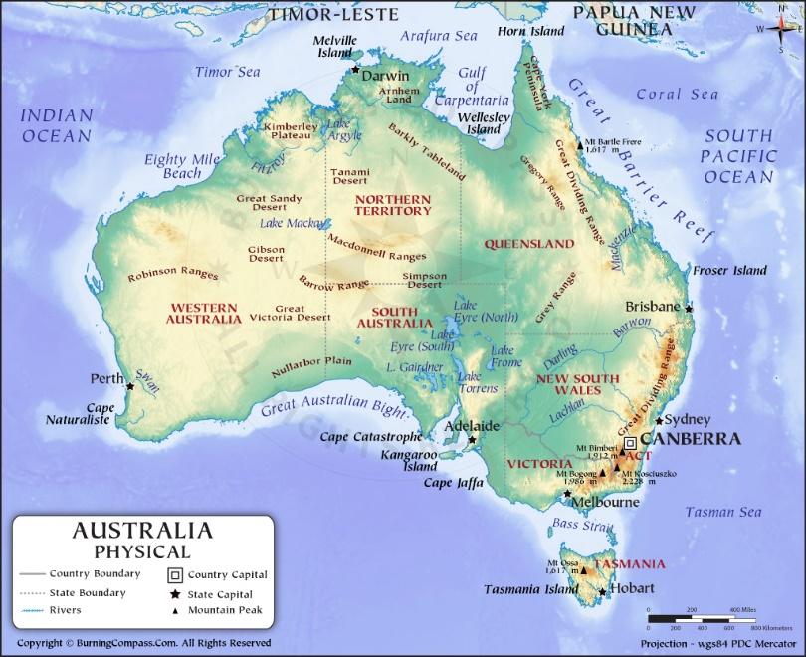
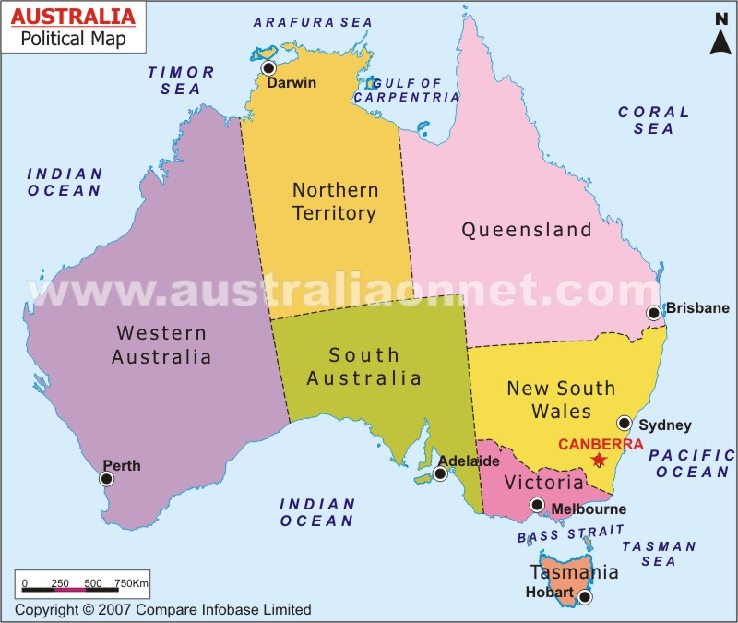
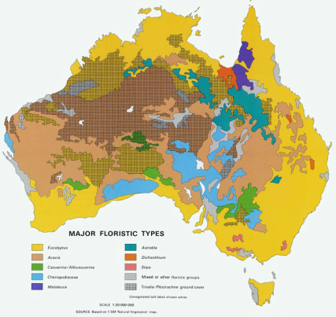
Using geographer’s tools
Different Types of Maps:
Physical Maps
Show natural features of the land
Political Maps
Show political boundaries (borders between countries/states)
Thematic Maps
Focus on a specific element of the place
Ex: Climate, population, resources, etc.
Thematic map

Slide 5
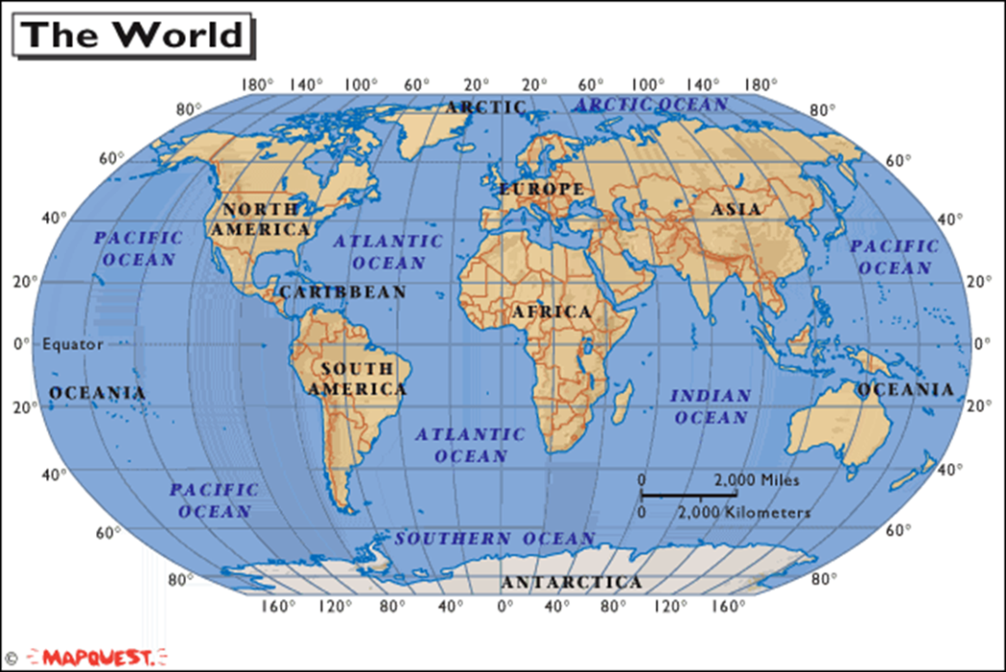
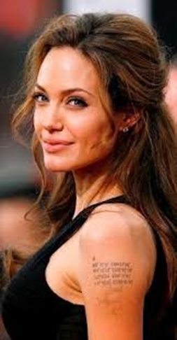
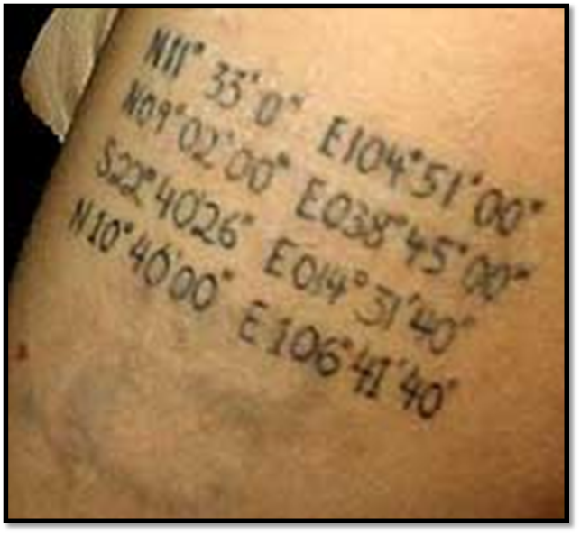
Using Geographer’s tools
Latitude and Longitude
Any place on earth can be found using coordinates (intersection of latitude and longitude)
L & L are measured in degrees

Slide 6
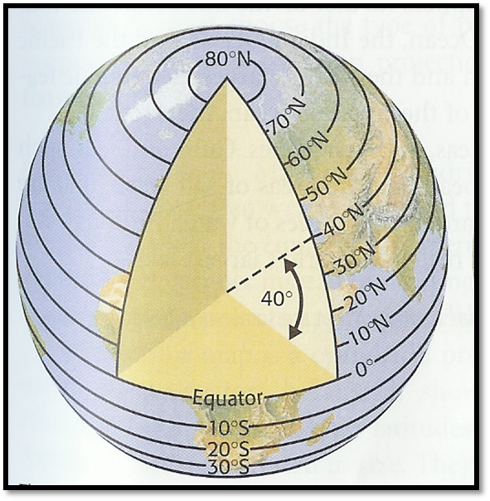
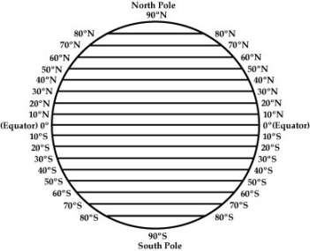
Latitude
Lines that run ACROSS the globe
Measure distances north and south of the Equator
The equator is the 0° line of latitude
Lines of latitude run from 0° to 90°

Slide 7
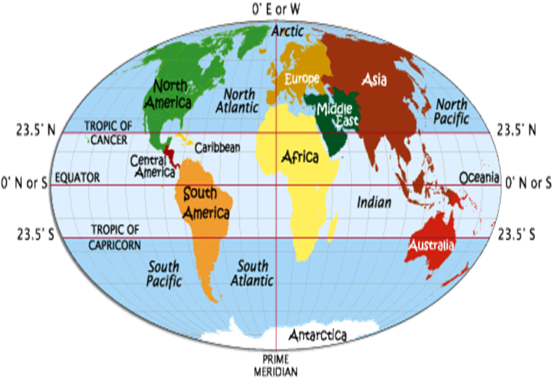
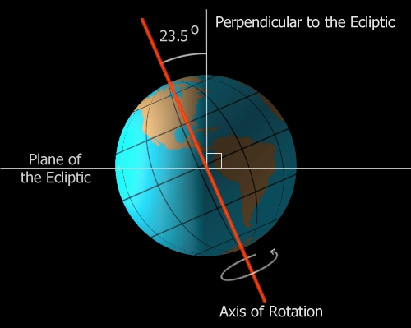
Latitude
Two lines of latitude that are very important
Tropics – places on the earth that receive the most heat from the sun.
The Tropic of Cancer at 23½˚ N
The Tropic of Capricorn at 23½˚S

Slide 8
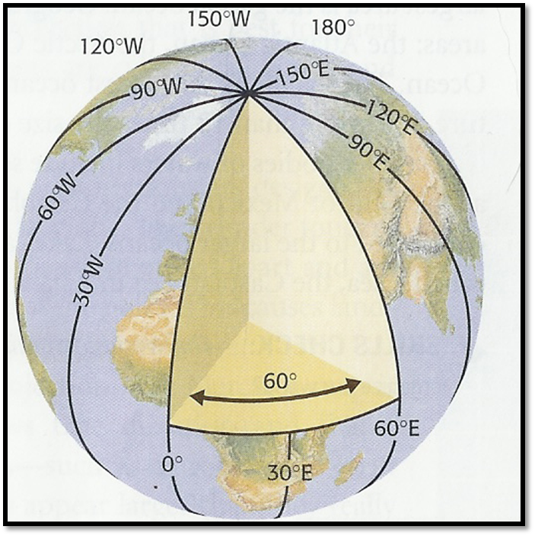
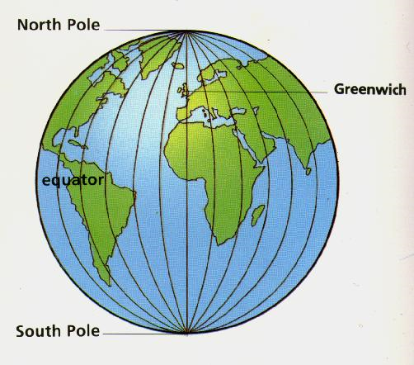
Longitude
-Lines of longitude are drawn up and down
-Measure places east and west of the Prime Meridian (0° longitude).
Prime Meridian runs through Greenwich, England
Lines of longitude run from 0° to 180°

Slide 9
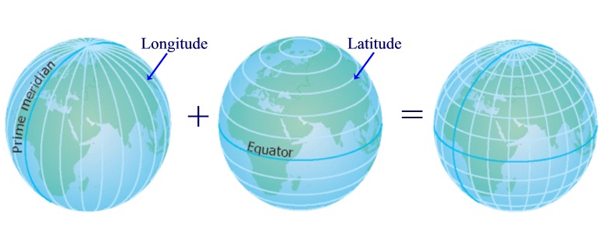
Writing Latitude & Longitude
Latitude will always have either North or South written before the degree
Longitude will always have either East or West before the degree
Latitude is always written first, then Longitude

Slide 10
Why is geography important to learn?
https://www.youtube.com/watch?v=5FVgg_u3auA
Write down as many reasons as you can in the next minute
Watch the video and add three more reasons to your list.

Slide 11
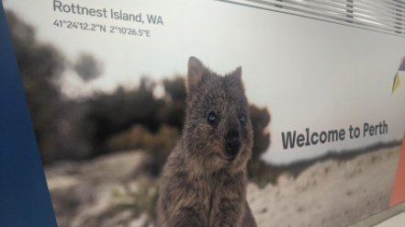
Latitude and Longitude
Rottnest Island advertisement – Perth Airport.
41°24'12.2"N 2°10'26.5"E
Would these coordinates match up with Australia?

Slide 12
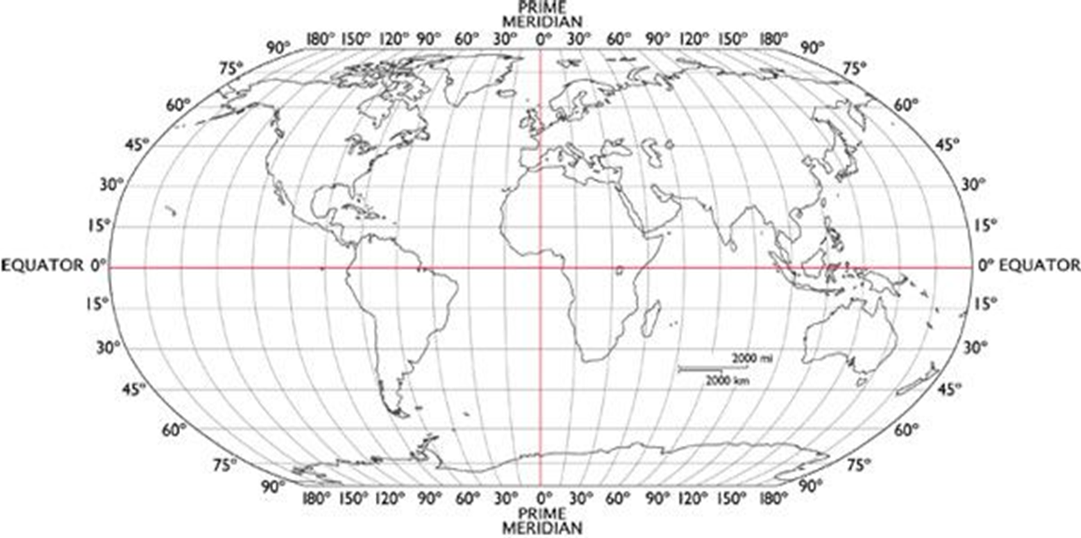

Slide 13
Board review
Brain Games

Slide 14
This measures areas north or south of the equator…
Longitude
Miles
Latitude
Tropics

Slide 15

This measures areas north or south of the equator…
Longitude
Miles
Latitude
Tropics

Slide 16
The measurements of latitude and longitude are always measured in
Angles
Coordinates
Degrees
Inches

Slide 17
The measurements of latitude and longitude are always measured in
Angles
Coordinates
Degrees
Inches

Slide 18
What is the hottest place on Earth due to direct sunlight?
Tropics
Prime Meridian
California
South

Slide 19
What is the hottest place on Earth due to direct sunlight?
Tropics
Prime Meridian
California
South

Slide 20
The coordinate 110° can only be describing…
The Western Hemisphere
Longitude
The Eastern Hemisphere
Latitude

Slide 21
The coordinate 110° can only be describing…
The Western Hemisphere
Longitude
The Eastern Hemisphere
Latitude

Slide 22
What is the line of 0° longitude called?
Equator
Parallel
Capricorn
Prime Meridian

Slide 23
What is the line of 0° longitude called?
Equator
Parallel
Capricorn
Prime Meridian

Slide 24
S- Space P- Place I- Interconnection C- change E- environment S- sustainability S- scale
Geography Key Concepts

Slide 25

space
The concept of space is about the significance of location and spatial distribution, and ways people organise and manage the spaces that we live in.
An understanding of the concept of space is developed in the following ways:
how characteristics of places are influenced by their location
how the distance between places are being decreased through transport and communication technologies
how spaces are perceived, structured, organised and managed by people.

Slide 26

place
The concept of place is about the significance of places and what they are like. They range in size from a part of a room or garden to a major world region.
An understanding of the concept of place is developed in the following ways:
how places are perceived, experienced, understood and valued differently
how the environmental characteristics of places are influenced by human actions and environmental processes
how the places in which we live are created, changed and managed by people

Slide 27

interconnections
The concept of interconnection emphasises that no object of geographical study can be viewed in isolation.
An understanding of the concept of interconnection is developed in the following ways:
thinking holistically and seeing the relationship between phenomena and processes within and between places

Slide 28

change
The concept of change is about explaining geographical phenomena by investigating how they have developed over time.
An understanding of the concept of change is developed in the following ways:
how environmental change can occur over both short and long-time frames
how environmental, economic, social and technological change is spatially uneven, and affects places differently

Slide 29

environment
The concept of environment is about the significance of the environment in human life, and the important interrelationships between humans and the environment.
An understanding of the concept of environment is developed in the following ways:
how the environment supports and enriches human and other life
how culture, population density, type of economy, level of technology, values and environmental worldviews influence the different ways in which people perceive, adapt to environments
How each type of environment has its specific hazards

Slide 30

sustainability
The concept of sustainability is about the capacity of the environment to continue to support our lives and the lives of other living creatures into the future.
An understanding of the concept of sustainability is developed in the following ways:
how progress towards environmental sustainability depends on the maintenance or restoration of the environmental functions that sustain all life and human wellbeing
unsustainability requires a study of the environmental processes producing the degradation of an environmental function and the human actions that have initiated these processes

Slide 31

scale
The concept of scale is about the way that geographical phenomena and problems can be examined at different spatial levels.
An understanding of the concept of scale is developed in the following ways:
how generalisations made, and relationships found differ at the local, regional, national and global levels.

Slide 32

Mix and Match
In your groups match the key concepts to their definitions…..
Then match the example to their concept and definition.

Slide 33
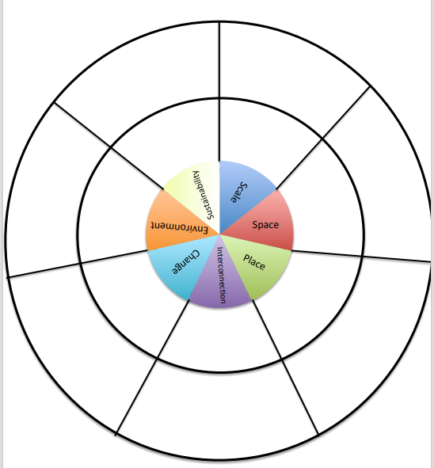
Concept wheel
Using your mixed and matched definitions, write down three key words and then draw a picture of each key concept.
Key Words
Draw Picture

Slide 34
Success Criteria
Can I define the study of Geography and provide examples.
Can I list the key concepts of Geography and explain each concept.
Can I list skills used in the study of Geography.

